Slide 1



Social Network Privacy and Security
Project5：
Decoding the Google Play Rating Black Box
BoFan Chen, YuHan Chen, ZiHan Chen, ZiXuan Wang, JiaShun Shi
2026.6.22
Notes:
Good evening, everyone. Now, I will begin the presentation of our project.

Slide 2


Content
Chapter1
Intro & Questionnaire Data Collection
Chapter2
Data Cleaning and Dataset Construction
Chapter3
Feature Engineering and Model Input Preparation
Chapter4
Machine Learning Model Training & Evaluation
Chapter5
Results Analysis and Safety Implications
Notes:
Our presentation is divided into the following sections:
Project Introduction & Data Collection
Data Cleaning & Dataset Construction
Feature Engineering & Model Input Preparation
Model Training & Evaluation
and Results Analysis

Slide 3
Intro & Questionnaire Data Collection
Question Structure Recovery and Sample Collection
IARC Rating Questionnaire
Notes:
First, I will briefly introduce the project and describe the process of data analysis and collection.

Slide 4
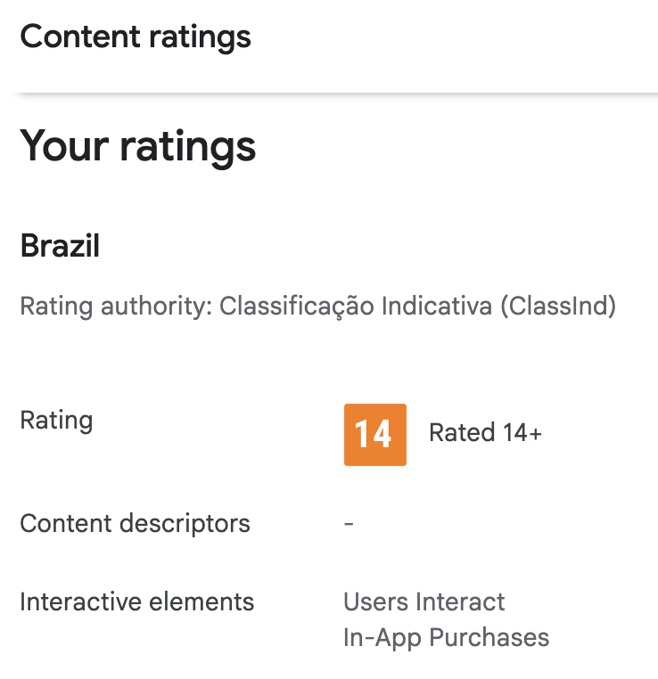
Intro
Main Purpose
App Categories
Obtain more than 1,000 questionnaires and completed response samples to train the machine learning model.
Game
The app is a game or betting app. Examples include: Candy Crush Saga, Temple Run, Mario Kart, The Sims, Angry Birds, casino games, interactive visual novels, management games, or daily fantasy sports.
Social or Communication
The primary purpose of this app is to meet or communicate with people. Examples include Facebook, Twitter, Skype, and SMS.
All Other App Types
Any app that isn't a game, social networking app, or communication app. Examples include entertainment products, consumer stores, news apps, lifestyle apps, streaming services, utilities, tools, emoji sets, fitness apps, magazines, and customizations.
Notes:
To begin with, Google Play provides a questionnaire service for developers to get a potential content rating evaluation for their apps. Google has not disclosed the algorithm behind, so it can be regarded as a black-box model.
Therefore, the core task of this project is to analyze this questionnaire, design a script to collect at least 1,000 sets of data, and train a machine learning model for rating prediction.
The questionnaires are categorized into three types: Game, Social or Communication, and Other.

Slide 5

Questionnaire
Notes:
This is the questionnaire interface, for example.
For each question you answered, there is a chance that one or more sub-questions are triggered. These sub-questions can trigger more sub-questions recursively.

Slide 6
Part 1: Recovering the Questionnaire Graph with DFS
Core idea
Root Question
• Start traversal from multiple root questions
• Click each option and record newly revealed child questions
• Apply the same recursive process to each child question
• Backtrack after each branch and continue exploring other options
Option: Yes
Option: No
Child Question
Terminate
DFS + Backtracking
Notes:
The Social questionnaire contains less than fifteen questions, and there are only 4,096 possible combinations for it. This means little significance for the machine learning research, so it was excluded from our scope.
For the other two categories, I implemented a DFS program to traverse the questions.
The program starts from the root questions of the questionnaire. By clicking each option sequentially, it identifies the sub-questions associated with that option, and then recursively traverses each sub-question. The program backtracks once it reaches a leaf node—meaning a point with no further sub-questions.

Slide 7
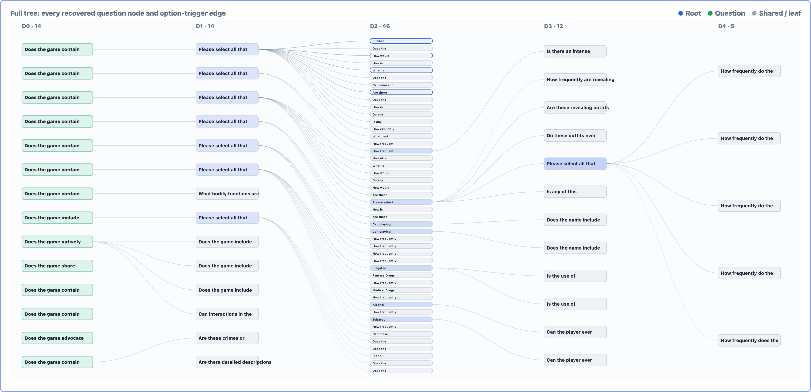
Recovered Structure: Complete Game Tree
Notes:
Ultimately, we obtained the following structure:
As you can see, the questionnaire consists of 14 root questions. A few of these root questions branch into several sub-questions, with a total depth of four layers.

Slide 8
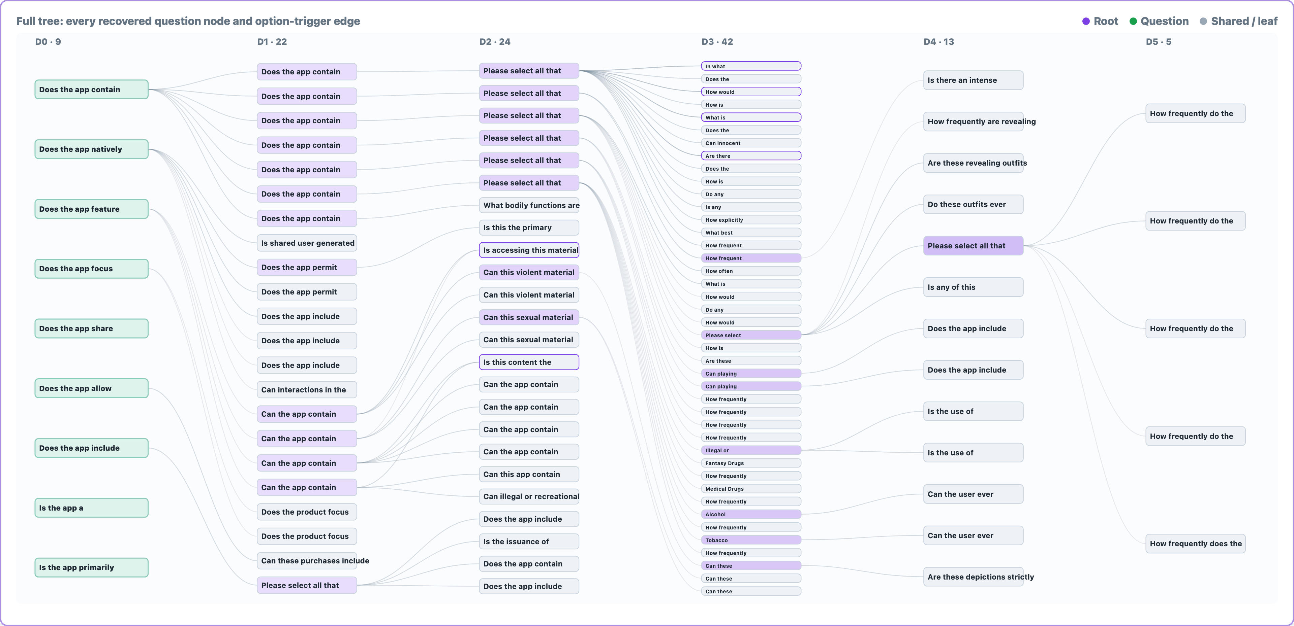
Recovered Structure: Complete All Other Tree
Notes:
This is the structure for the other category. It has more questions and more layers.

Slide 9
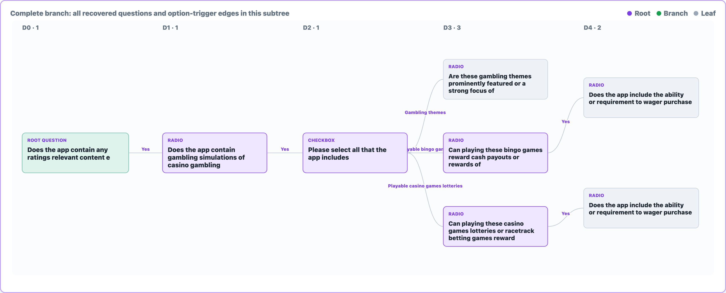
An Example Question with one of its options and sub-questions
Notes:
And this is a single branch of a question for example. It has 4 layers of sub-questions about whether there are gambling elements in the app.

Slide 10
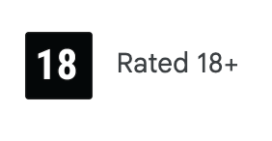
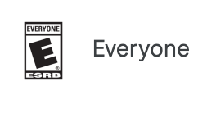
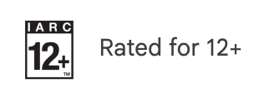
Questionnaire Sample Collection
1
2
3
4
Baseline
Structural coverage
Risk paths
Gap filling
Choose the lowest-risk answers to establish the minimum-rating path
Prioritize options that reveal child questions and increase coverage
Combine risk type and severity choices to cover different rating outcomes
Identify low-frequency options and add targeted supplemental samples
Notes:
To acquire sufficient and well-distributed data, I used the following sampling methods:
Firstly, select “No” for all questions to obtain the lowest rating result, which results in ”Everyone“ as the baseline.
Secondly, I prioritized options that trigger sub-questions. This step improves question coverage and lays the foundation for the next sampling.
Thirdly I manually annotated every option of each question by labeling the risk types involved (such as gambling, drugs, and in-app purchases) and gave a score to indicate severity level of its options. By answering the questionnaire with a either single risk item, multiple risk items, or all risk items.
Since I had given score to the options, this progress can be dynamically changed to achieve lower of higher ratings. By doing this, I am able to cover sufficient data from Teenager to Adult-Only classification.
Lastly, I collected data for options or questions that appeared with lower frequencies in the previous steps.

Slide 11
Final Data Distribution
ESRB Label Distribution
Mature 17+
365
Teen
339
Adults only 18+
241
Everyone
182
The samples cover the major rating labels
from Everyone to Adults Only 18+,
supporting downstream multi-class modeling.
Everyone 10+
138
Notes:
The final distribution of the collected data is shown in the chart. As you can see, each age rating category has been evenly and adequately covered, with a total number of over 1,000 records of data.

Slide 12

Chapter 2:
Data Cleaning and Dataset Construction
Dataset Standardization:
From Raw Questionnaire Records to Reproducible Train/Test Splits
Presenter:JiaShun Shi
Chapter 4:
Machine Learning Model Training & Evaluation
Algorithm Benchmarking:
From High-Dimensional Sparse Features to Age Rating Prediction

Slide 13
Data Cleaning and Dataset Construction
Turning raw questionnaire collection records into clean, auditable train/test datasets.
📋 What this stage Does
📊 1,265 Validated Clean Samples
After validation and consistency checks, all 1,265 retained records formed the clean dataset.
Core Objective: Standardization & Boundaries
Processes raw questionnaire records into a structured, clean dataset. This phase strictly stops at dataset construction—no feature encoding, label transformation, or model training is included here.
📂 Deterministic Train / Test Split (80/20)
The clean data was partitioned into 1,012 training rows and 253 test rows, stratified by app category and North America rating label.
🔍 Input Boundary
Source: dataset_v2/samples.jsonl. Validated against schema files, question dependency graphs, quarantine logs, and rating-conflict reports.
📂 Output Boundary
Generated under task3_data_cleaning/output: clean_dataset.csv, split train/test CSVs, and audit files for exclusions, split distribution, source hashes, and cleaning summary.
✅ 0 Validation Errors in Pipeline
All data integrity checks passed without exceptions. Upstream anomalies and conflicts are preserved in audit files for traceability.
Outcome: a fully reproducible cleaned dataset with unified fields, explicit missing-value markers, and auditable exclusion records.
Notes:
In this section, I will introduce the data cleaning and dataset construction stage of our project.
The goal of this stage is to turn the raw questionnaire collection records into a structured, clean, and auditable dataset.
This part has a clear boundary. We do not perform feature encoding, label transformation, or model training here. Instead, we focus on standardizing the collected records, validating their structure, handling missing values, and producing reproducible train and test datasets.
After validation and consistency checks, we retained 1,265 clean samples. These samples were split into 1,012 training rows and 253 test rows. All cleaning-stage integrity checks passed, and upstream anomalies or conflicts were preserved in audit files for traceability.

Slide 14
From Raw JSONL to Valid Samples
Each record is validated against structural schema, answer consistency, branch reachability, and category-specific rating regions.
pipeline-card-1
pipeline-card-1
pipeline-card-1
pipeline-card-1
pipeline-card-1
01 Source Records
02 Schema validation
03 Answer Consistency
04 Branch Reachability
05 Clean samples
questionnaire states +
rating outputs
>
schemaVersion, sample_id, category, required fields
>
radio/checkbox selections and explicit answers
>
active branches checked with question_graph.json
>
retained for flattening and train/test split
result-badge
VALIDATION PASSED: 1,265 retained samples | 0 Task 3 validation errors | 0 unexpected blank output cells
Structure & Identity
Answer Consistency
Branch Logic
Rating Completeness
Checked schemaVersion equals 2, non-empty sample_id, valid category, and required arrays.
Catches missing IDs, invalid categories, and malformed records.
Radio questions must have one selected option.
Checkbox selections and explicit answers must match the recorded question state.
Active questions are recomputed from question_graph.json.
Detects skipped child questions and inactive questions mixed into a sample.
Returned rating regions are checked by app category.
Game includes Australia, Saudi Arabia, and Taiwan; non-game categories use common regions.
Notes:
This slide shows the validation pipeline from raw JSONL records to valid samples.
The input records contain questionnaire states and rating outputs. First, we check the structural schema, including the schema version, sample ID, category, and required fields. Then, we validate answer consistency, making sure radio and checkbox selections match the recorded explicit answers.
Next, we use the questionnaire dependency graph to recompute active branches. This helps detect skipped child questions or inactive questions that should not appear in a sample. Finally, we check rating completeness by app category. For example, game samples include additional regions such as Australia, Saudi Arabia, and Taiwan.
As a result, 1,265 records were retained, with zero validation errors in this cleaning stage and zero unexpected blank output cells.

Slide 15
Making the Dataset Clean and Auditable
The cleaning logic remains explicit: what was retained, what was excluded, and how missing structure is represented.
🔍 Deduplication
📋 Anomaly Audit
🏷 Missing Values
Duplicates are identified by the complete questionnaire state, not only by the explicit answer list.
The audit log keeps upstream anomalies visible instead of silently discarding their history.
Missingness is structural, so it is marked explicitly rather than statistically imputed.
__INACTIVE__
branch not activated
Exact duplicate groups: one record retained per group.
Same state with different ratings: whole conflict group excluded.
Duplicate key: complete semantic questionnaire state.
0
newly excluded during cleaning
__NOT_APPLICABLE__
category or region not applicable
30
upstream category anomalies
__NONE__
active checkbox with no selected option
13
upstream rating conflicts
Unexpected blank cells: 0
Audit file: excluded_samples.csv
No mean or mode imputation was used. Every structural missing-value marker has a documented meaning.
Notes:
This slide summarizes how we handled duplicates, anomalies, and missing values.
For deduplication, we did not compare only the explicit answer list. Instead, we used the complete questionnaire state as the duplicate key. Exact duplicate groups retain one record, while samples with the same questionnaire state but different rating outputs are treated as rating conflicts and excluded as a group.
For anomaly audit, this cleaning stage did not newly exclude any sample from the current clean dataset. However, upstream anomalies are still preserved for transparency, including 30 category anomalies and 13 upstream rating conflicts.
For missing values, we did not use mean or mode imputation. Instead, structural missingness is explicitly marked using __INACTIVE__, __NOT_APPLICABLE__, and __NONE__, so every special value has a documented meaning.

Slide 16
Unified Wide-Table Format
Nested questionnaire records are flattened into one row per sample with consistent column names.
📋 Questionnaire Answer Normalization
sample_id | category | answer__<question_id> | rating__<territory>
game_00042 | Game | Yes || Moderate | Mature 17+
app_00118 | All Other App Types | No | Teen
📝 Questionnaire answers
answer__* columns store standardized questionnaire responses. Radio questions keep the selected option. Checkbox questions join multiple selected options with " || ".
⭐ Rating Outputs
rating__* columns store the original regional rating labels returned by the questionnaire result page. They are output labels, not cleaned answer fields.
📊 Dataset Scale & Structural Consistency
The schema includes 164 answer columns and 10 regional rating columns. clean_dataset.csv includes the split column.
train.csv and test.csv share identical columns.
Notes:
After validation and cleaning, the nested questionnaire records are flattened into a unified wide-table format.
Each row represents one cleaned questionnaire sample. The table contains sample identifiers, the app category, normalized questionnaire answers, and regional rating outputs. The answer__* columns store standardized questionnaire responses. For radio questions, the selected option is kept directly. For checkbox questions, multiple selected options are joined using the || delimiter.
The rating__* columns store the original regional rating labels returned by the questionnaire result page. These are output labels, not cleaned answer fields.
In total, the schema includes 164 answer columns and 10 regional rating columns. The full cleaned dataset contains a split column, while train.csv and test.csv share identical column structures.

Slide 17
Reproducible Train/Test Dataset
The cleaned dataset is split once using deterministic stratification and is accompanied by audit evidence.
​
​
​
1,265
→
1,012
+
253
clean samples
train rows
test rows
📊 Split rule
📂 Category Distribution
🔍 Delivered Artifacts
​
​
Method
deterministic stratified holdout
Category | Total | Share
All Other App Types | 616 | 48.7%
Game | 633 | 50.0%
Social or Communication | 16 | 1.3%
Cleaned Dataset
Train/Test Split
Normalized samples with unified field names.
Reproducible subsets with identical columns.
Strata
app category x North America
rating label
Test ratio
​
​
20%
Field Documentation
Audit Evidence
Column roles, question definitions, and missing-value meanings.
Excluded records, split distributions, source hashes, and cleaning reports.
Reproducibility
fixed deterministic split
Final Outcome: clean rows, traceable exclusions, consistent field names, and reproducible splits.
Notes:
The final step of this stage is to produce a reproducible train and test split.
From the 1,265 clean samples, we generated 1,012 training rows and 253 test rows. The split uses deterministic stratified holdout. The stratification is based on app category and the North America rating label, with a 20% test ratio. This makes the split reproducible while preserving the main category and rating distribution.
The category distribution is also recorded: 616 samples are from All Other App Types, 633 are Game samples, and 16 are Social or Communication samples.
The delivered artifacts include the cleaned dataset, the train/test split, field documentation, and audit evidence. Together, these outputs provide clean rows, traceable exclusions, consistent field names, and reproducible splits for the following stages of the project.

Slide 18
Chapter 3:
Feature Engineering and Model Input Preparation
Presenter:Bofan Chen
Chapter 4:
Machine Learning Model Training & Evaluation
Algorithm Benchmarking:
From High-Dimensional Sparse Features to Age Rating Prediction
Notes:
This part is about Task 4, feature engineering and model input preparation.

Slide 19
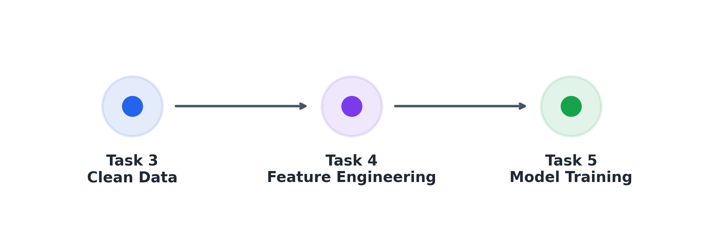
Goal: Convert cleaned questionnaire data into model-ready inputs.
✅ Main responsibilities:
• Convert raw answers into numerical features
Connects the cleaned dataset with training
• Prepare train / validation / test datasets
• Encode North America age rating labels
• Prevent target leakage from rating outputs
• Generate reusable metadata for model training
Notes:
In the whole project pipeline, our work is between data cleaning and model training. Task 3 provides a clean dataset, but the data is still in a raw questionnaire format. Machine learning models cannot directly use these text answers.
So our goal is to convert the cleaned questionnaire answers into numerical model inputs. Specifically, we encode different types of questions, prepare train, validation, and test datasets, encode the North America rating labels, and generate reusable metadata for the modeling stage.
A very important requirement in this step is to avoid target leakage, because the dataset contains multiple regional rating outputs.

Slide 20
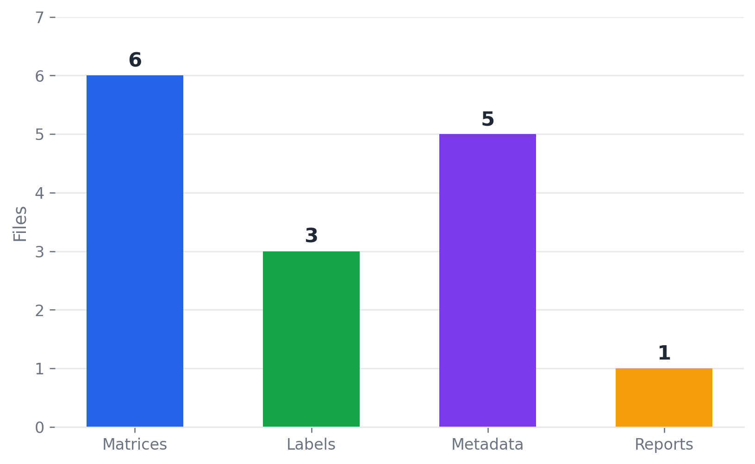
Input and Output
✅ Input from Task 3:
• train.csv
• test.csv
• column_groups.json
• data_dictionary.csv
✅ Output for Task 5:
• CSV feature matrices
• Sparse NPZ matrices
• Encoded labels
• Feature dictionary
• Label mapping
• Class weights
• Engineering report
Notes:
For the input, we mainly use four files from Task 3.
The first two are train.csv and test.csv, which contain the cleaned questionnaire samples. The other two are column_groups.json and data_dictionary.csv. These metadata files tell us which columns are features, which columns are target labels, and what type each question is.
After feature engineering, we generate several outputs for Task 5. The most important ones are X_train, X_val, and X_test, which are the encoded feature matrices. We also generate y_train, y_val, and y_test as encoded labels.
Besides that, we provide a feature dictionary, label mapping, class weights, sparse matrix files, and an engineering report. These files make the next modeling step easier and more reproducible.

Slide 21
Target and Leakage Control
rating__north_america
Prediction
target
Allowed model inputs
• category
• answer__*
questionnaire fields
• All regional rating fields are outputs of the same questionnaire.
• Using them as input features would leak the answer into the model.
• sample_id
• split
• all rating__* columns
Excluded columns
Reason
Notes:
In this task, we choose rating__north_america as the prediction target. This corresponds to the ESRB-style age rating in North America.
For model inputs, we only allow the questionnaire category and the answer columns. These columns start with answer double underscore.
We explicitly exclude sample_id, split, and all rating columns. This is important because all regional rating fields are outputs of the same questionnaire. If we use one regional rating to predict another regional rating, the model would indirectly see the answer.
So this leakage guard makes sure that the model learns from questionnaire answers, not from other rating results.

Slide 22
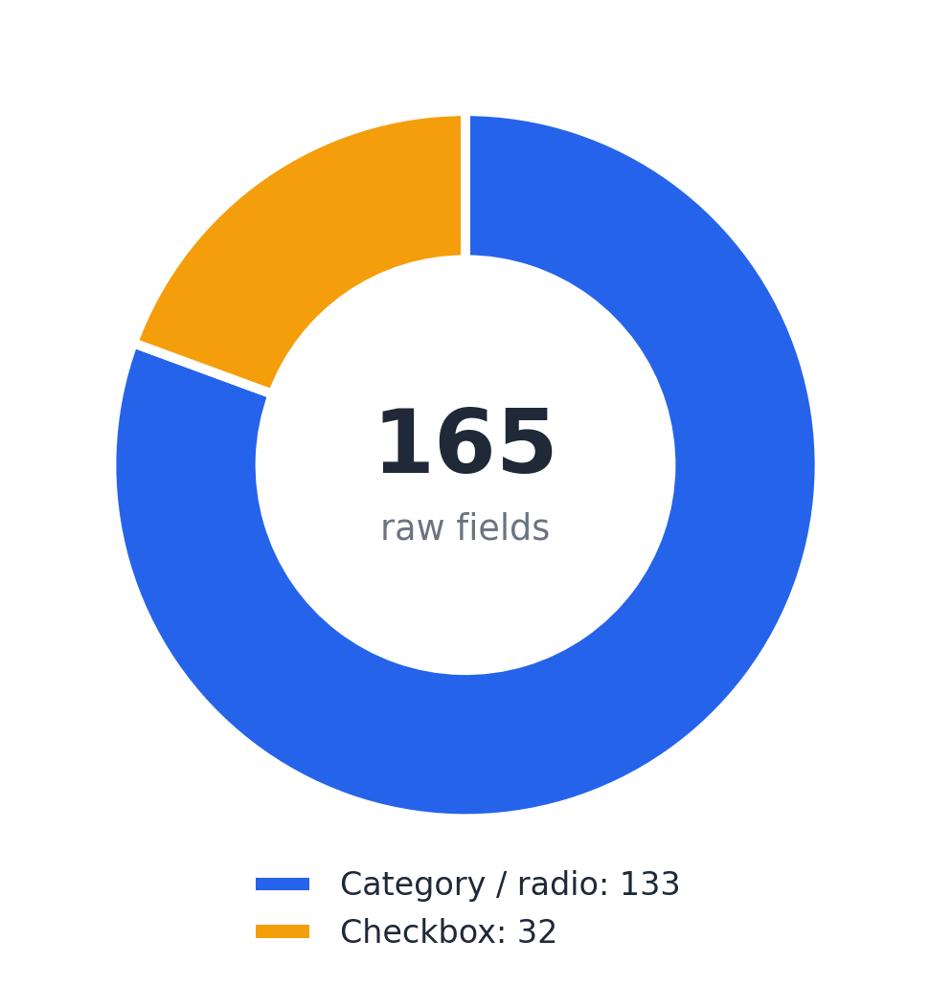
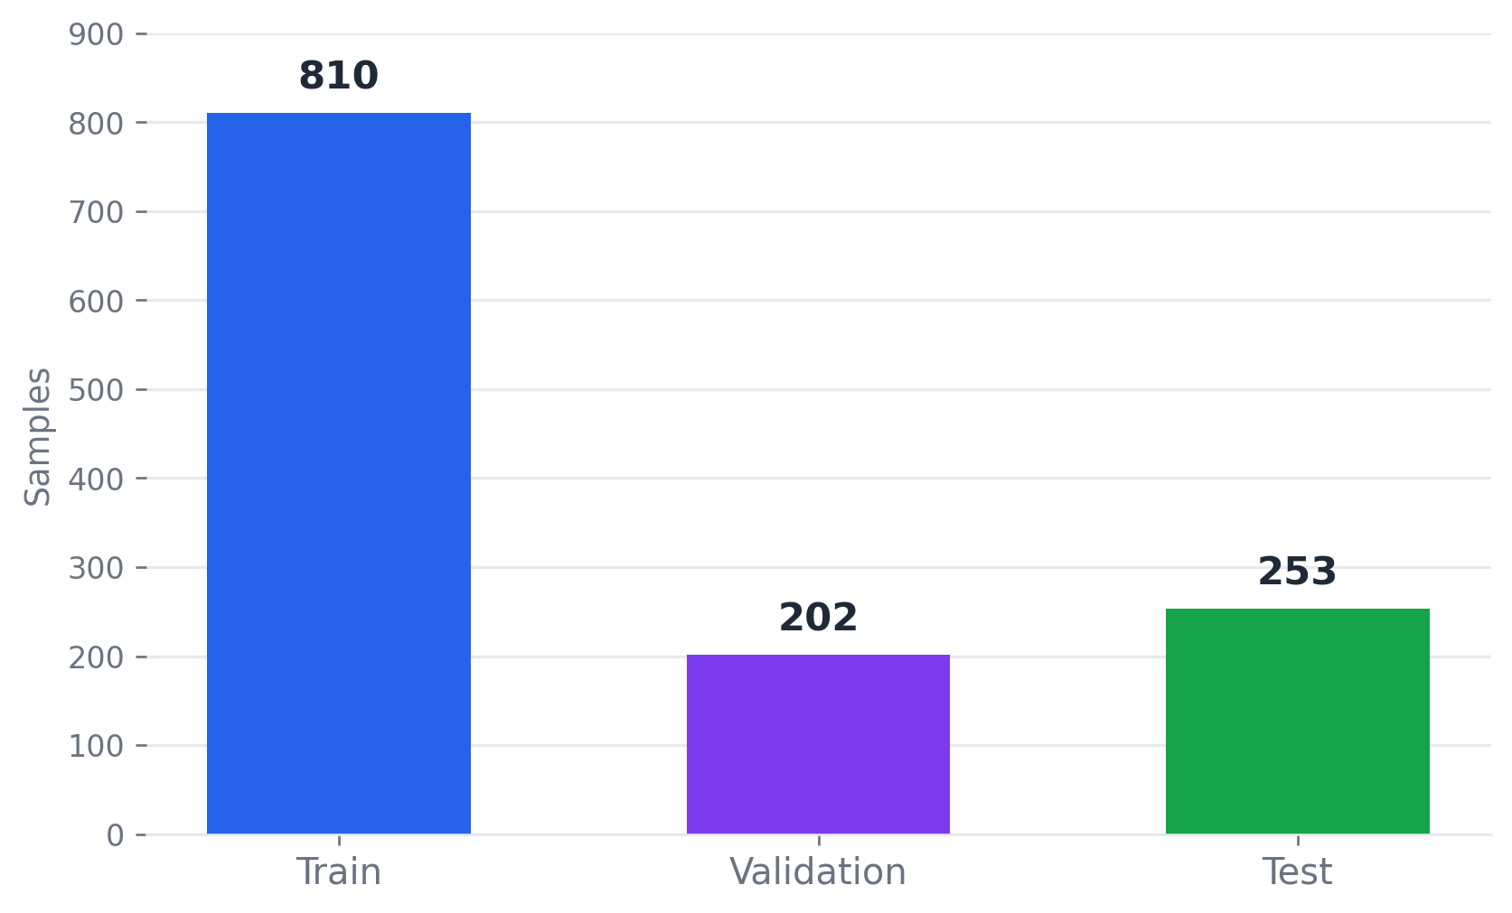
Encoding Strategy & Dataset Split
Raw feature types
The original Task 3 test set is kept unchanged.
Task 4 split:
• Train: 810 samples
• Validation: 202 samples
• Test: 253 samples
The validation set is split from Task 3 train.csv using a fixed seed.
The split is stratified by category and North America rating.
单击此处添加图表标题
Encoding rules:
• Category fields are one-hot encoded
• Radio questions are one-hot encoded
• Checkbox questions are expanded into multi-hot features
• Structural missing markers are preserved as explicit values
Notes:
The cleaned dataset still contains categorical text values, so we need to encode them into numerical features.
For the category field and radio questions, we use one-hot encoding. Each possible answer becomes a binary feature.
For checkbox questions, one sample may select multiple options. Therefore, we split the combined answer string and convert it into multi-hot features.
We also preserve structural missing values, such as inactive questions and not applicable questions. These values are meaningful because the questionnaire has a tree-like structure. If a question is inactive, that itself tells us something about the previous answers.
/////
Task 3 already provides a train and test split, and we keep the original test set unchanged.
From the Task 3 training set, we further split out a validation set. Finally, we have 810 training samples, 202 validation samples, and 253 test samples.
The validation split uses a fixed seed, so the result is reproducible. It is also stratified by questionnaire category and North America rating, so the label distribution is kept as stable as possible across different splits.
This gives Task 5 a clean setup for model training, model selection, and final testing.

Slide 23
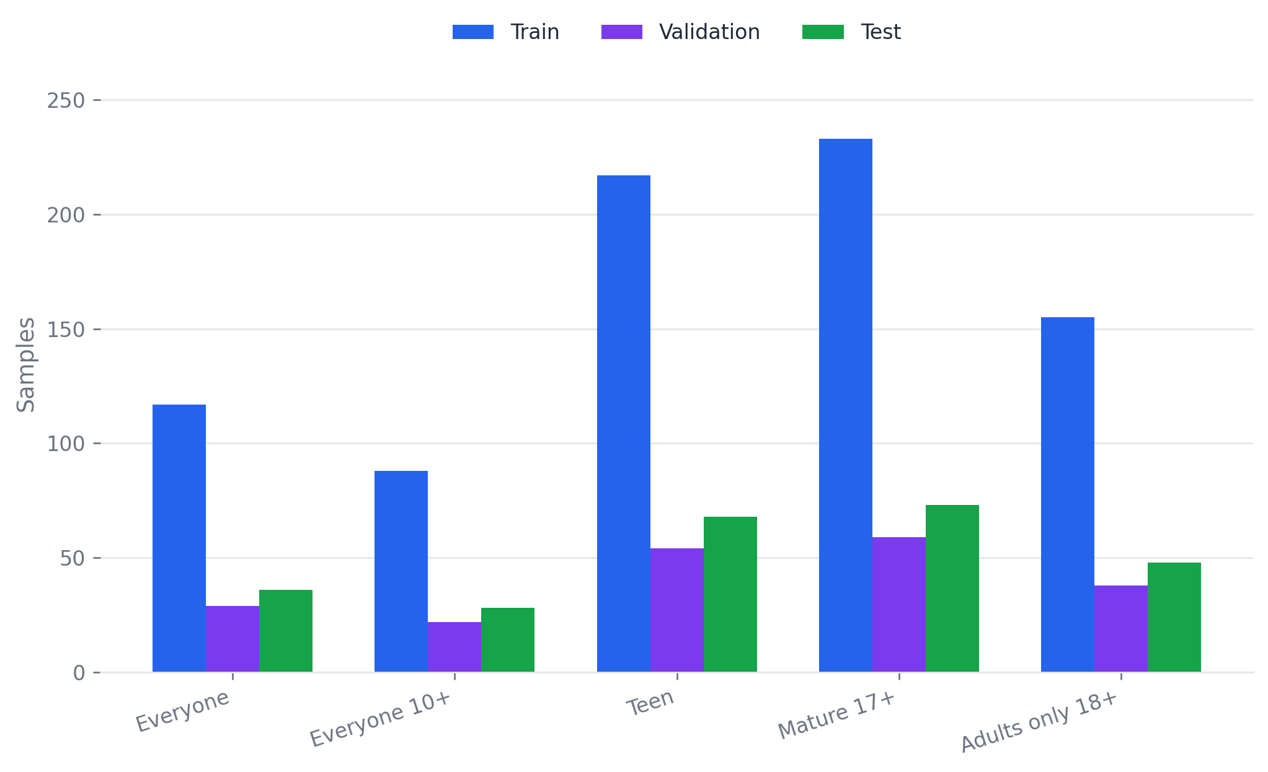
Target Label Distribution
🔄 Classes:
• Everyone • Teen • Everyone 10+ • Mature 17+ • Adults only 18+
⚙ The distribution is moderately imbalanced, so class weights are also generated for downstream models.
The target is a five-class ESRB-style classification problem.
Notes:
Here we show the distribution of the North America rating labels.
The task is a five-class classification problem. The five classes are Everyone, Everyone 10+, Teen, Mature 17+, and Adults only 18+.
The distribution is not perfectly balanced. Mature 17+ and Teen have more samples, while Everyone 10+ has fewer samples. This imbalance may affect model training, especially for minority classes.
Because of this, we also generate class weights, so downstream models can reduce bias toward majority classes.

Slide 24
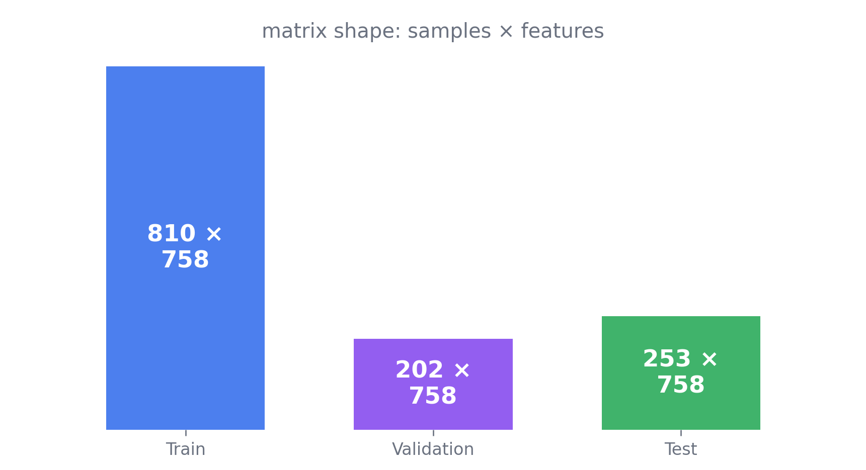
Feature Space
🔄 Raw feature columns: 165
⚙ Encoded feature columns: 758
📊 The feature space expands because:
• Radio answers become one-hot indicators
• Checkbox answers become multiple binary indicators
• Missing-state markers are also encoded
Matrix Shapes
Notes:
After encoding, the feature space becomes much larger.
Originally, we have 165 raw feature columns. After one-hot and multi-hot encoding, we get 758 encoded feature columns.
This expansion is expected. Radio questions produce one binary feature for each possible answer, and checkbox questions can produce multiple binary indicators for different selected options.
The final output is a binary feature matrix, which can be directly used by common machine learning models such as logistic regression, random forest, support vector machines, or gradient boosting models.

Slide 25
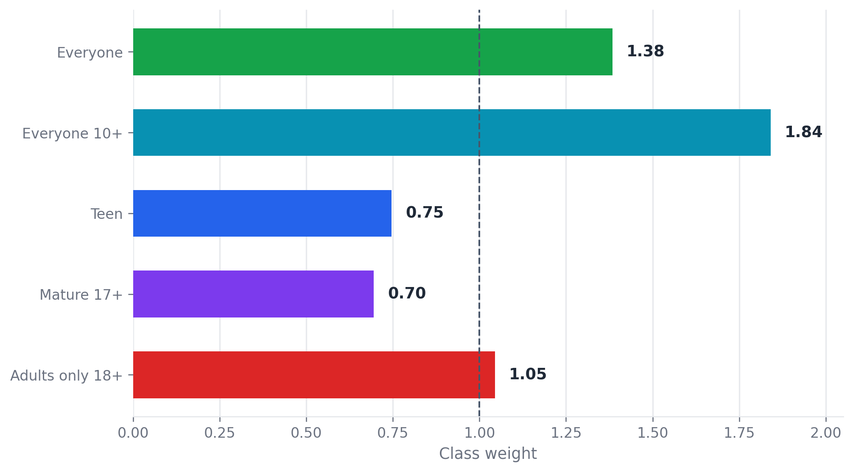
Class Imbalance and Final Checks
🔄 Purpose:
• Reduce bias toward majority classes
• Improve learning for smaller classes
• Support models using class_weight="balanced"
⚙ Final validation checks:
• Same feature columns across train, validation, and test
• No missing values in encoded matrices
• No rating leakage
• Reproducible split and metadata
🛡 Class weights are generated for Task 5 model training
Notes:
Finally, we generate balanced class weights for the model training stage.
The purpose is to reduce the model's bias toward majority classes and give more importance to smaller classes. For example, Everyone 10+ receives a higher weight because it has fewer training samples.
Before delivering the outputs, we also run several validation checks. We make sure that train, validation, and test have exactly the same feature columns. We check that there are no missing values in the encoded matrices. We also verify that no rating columns are included as model inputs.
Overall, Task 4 produces a clean, reproducible, and leakage-free feature engineering pipeline for Task 5 model training.

Slide 26
Chapter 4:
Machine Learning Model Training & Evaluation
Algorithm Benchmarking:
From High-Dimensional Sparse Features to Age Rating Prediction
Presenter:ZiHan Chen
Chapter 4:
Machine Learning Model Training & Evaluation
Algorithm Benchmarking:
From High-Dimensional Sparse Features to Age Rating Prediction

Slide 27
Modeling Challenges & Core Strategies
⚠ Data Challenges
🛡 Algorithm Diversity: Broad Evaluation
Evaluated 4 classic classification algorithms (Linear vs. Tree-based models) to capture different patterns in the sparse, high-dimensional data landscape.
1. High Dimensionality vs. Small Sample Size
Only 810 training samples, but expanded to 758 dimensions after One-Hot Encoding, leading to the classic "curse of dimensionality".
⚖ Imbalance Handling: Weighted Optimization
Enforced class_weight='balanced' across all models to automatically adjust weights inversely proportional to class frequencies, mitigating majority class bias.
2. Extreme Matrix Sparsity
The vast majority of features are marked as 'No' or 'INACTIVE', which drowns valid signals in a sea of zeros and reduces model sensitivity.
📊 Fair Benchmarking: Rigorous Validation
Applied strict 5-Fold Cross-Validation (GridSearchCV) uniformly to all models, ensuring a consistent, unbiased comparison of performance metrics.
3. Severe Class Imbalance
Uneven distribution across 5 age rating categories risks the model being biased towards the majority class.

Slide 28
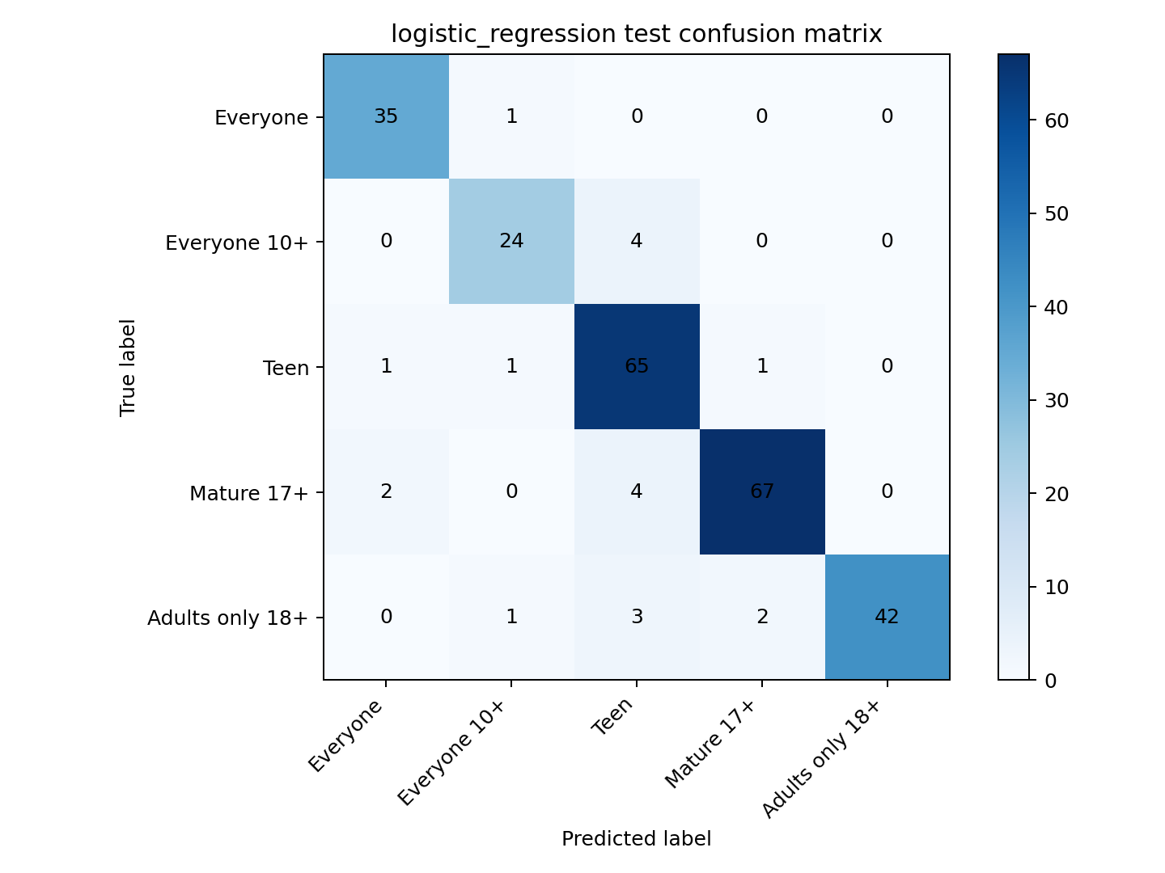
Model 1: Logistic Regression (The Sparse Champion)
🔄 Model Intro
A classic linear classifier utilizing regularization penalties. It is naturally suited for high-dimensional and extremely sparse feature spaces.
⚙ Training Process
Conducted an exhaustive Grid Search with 53 parameter combinations via 5-Fold CV. The tuning focused on the regularization penalty (l1_ratio), inverse regularization strength (C), and adopting the saga solver optimized for large sparse datasets.
Test Set Accuracy
0.921
Macro F1 Score
0.918
📊 Optimal Hyperparameters:
l1_ratio=1.0 (Pure L1 Lasso),C=10.0, solver='saga'
💡 Insight: Pure L1 Regularization automatically triggered extreme feature selection.

Slide 29
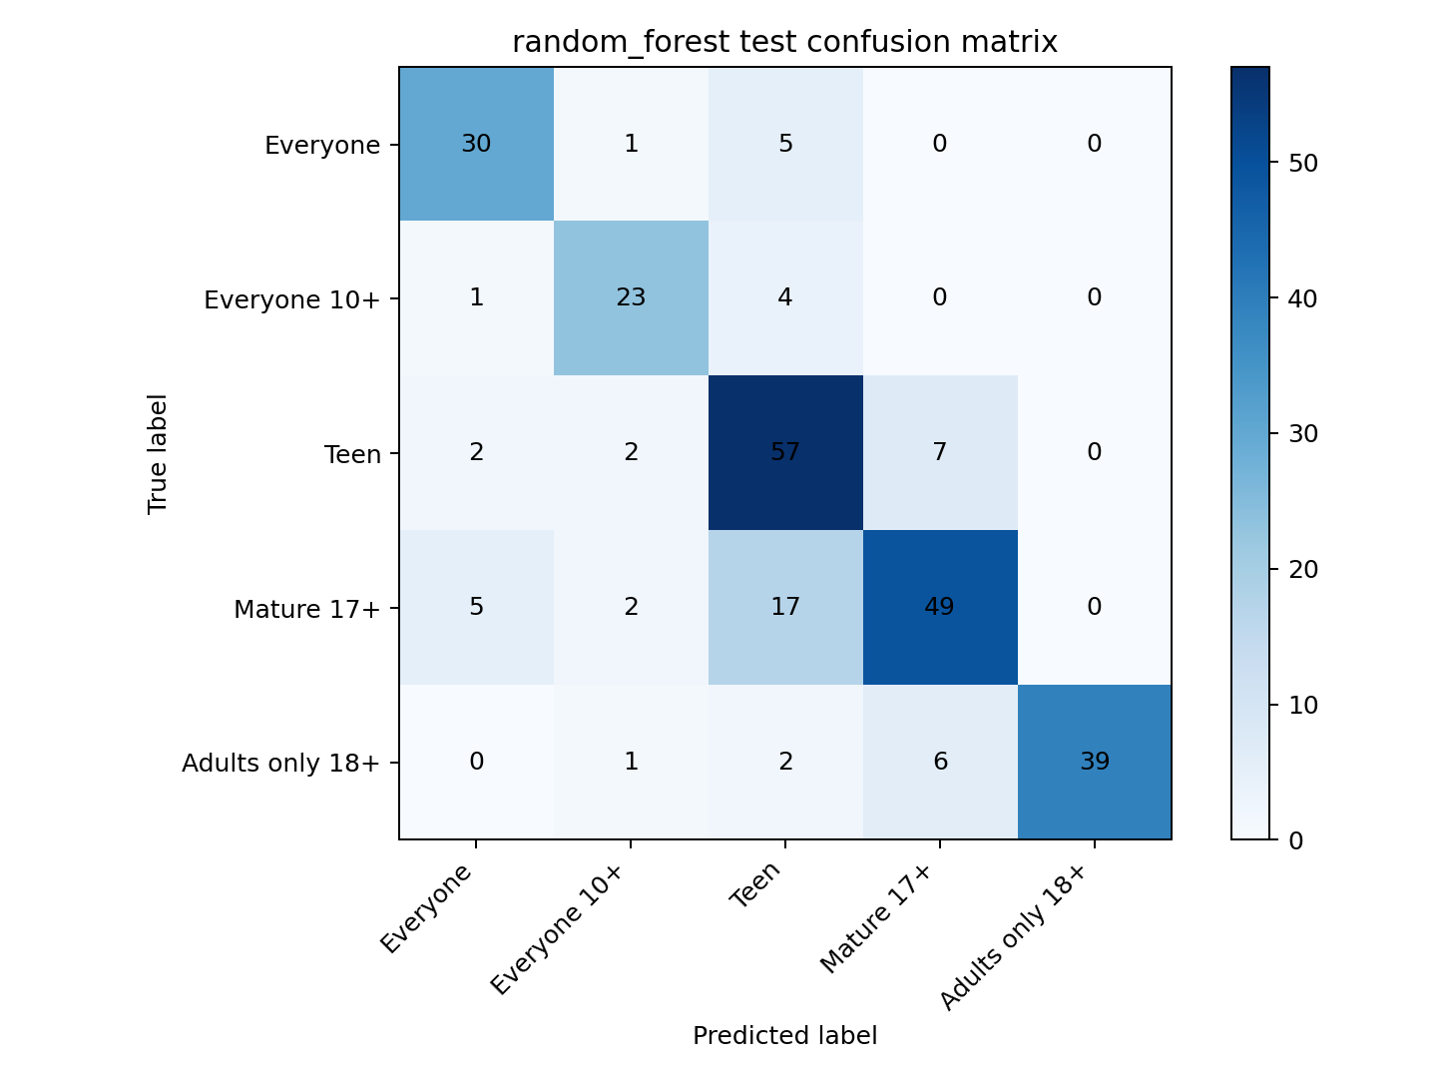
Model 2: Random Forest (The Unconstrained Baseline)
🔄 Model Intro
A classic Bagging ensemble model that builds multiple decision trees to capture complex non-linear relationships.
⚙ Training Process
Performed a 162-combination Grid Search (5-Fold CV) to optimize tree splitting mechanics. The search space heavily explored maximum tree depth (max_depth), minimum leaf samples (min_samples_leaf), and feature sampling rates (max_features).
Test Set Accuracy
0.783
Macro F1 Score
0.797
📊 Optimal Hyperparameters:
max_depth=None, min_samples_leaf=1, max_features=0.3
⚠Warning: max_depth=None led to severe overfitting (memorization) on the small training set.

Slide 30
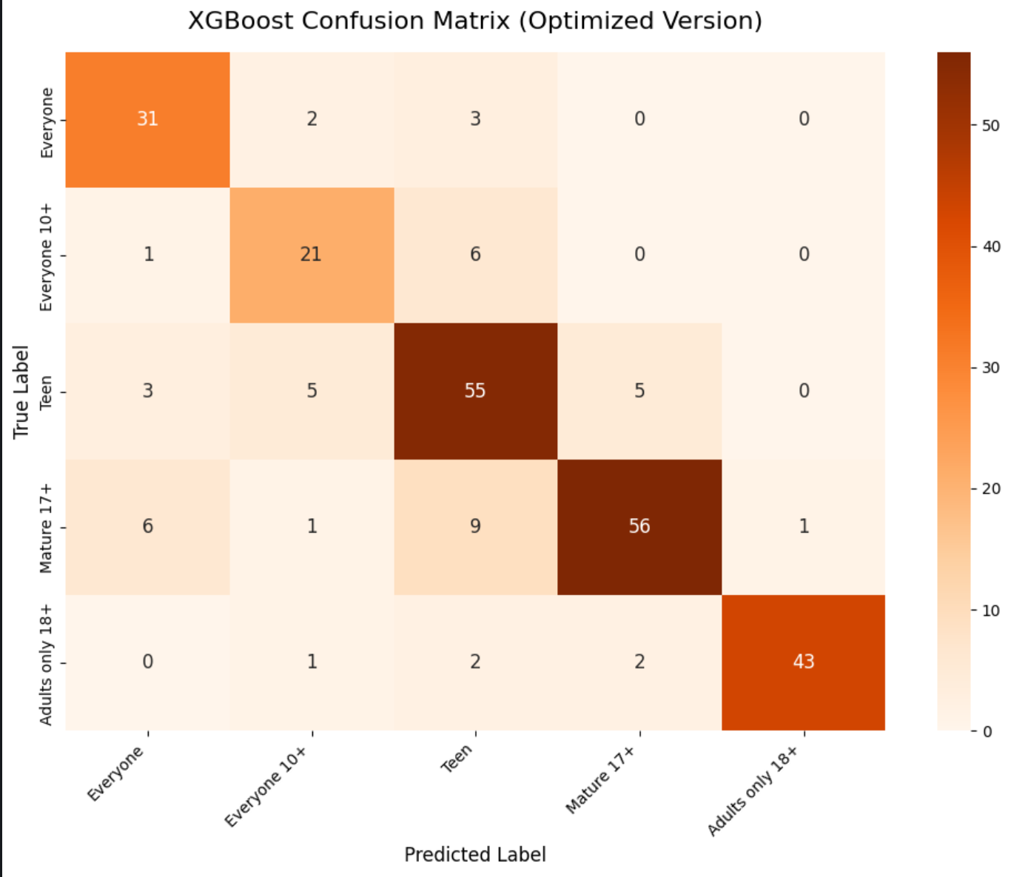
Model 3: XGBoost (The Robust Performer)
🔄 Model Intro
A highly optimized Gradient Boosting Decision Tree (GBDT) framework with built-in sparsity-aware split finding.
⚙ Training Process
Implemented a 2-stage training pipeline to prevent overfitting.
Stage 1: Anti-overfitting Grid Search limiting tree depth and feature sampling.
Stage 2: Final training with 500 estimators utilizing Early Stopping (patience=30) monitored on an independent validation set.
Test Set Accuracy
0.814
Macro F1 Score
0.810
📊 Optimal Hyperparameters:
max_depth=6, colsample_bytree=0.8, subsample=1.0
🛡 Strategy: Constrained depth feature sub-sampling forced the model to learn true generalized rules.

Slide 31
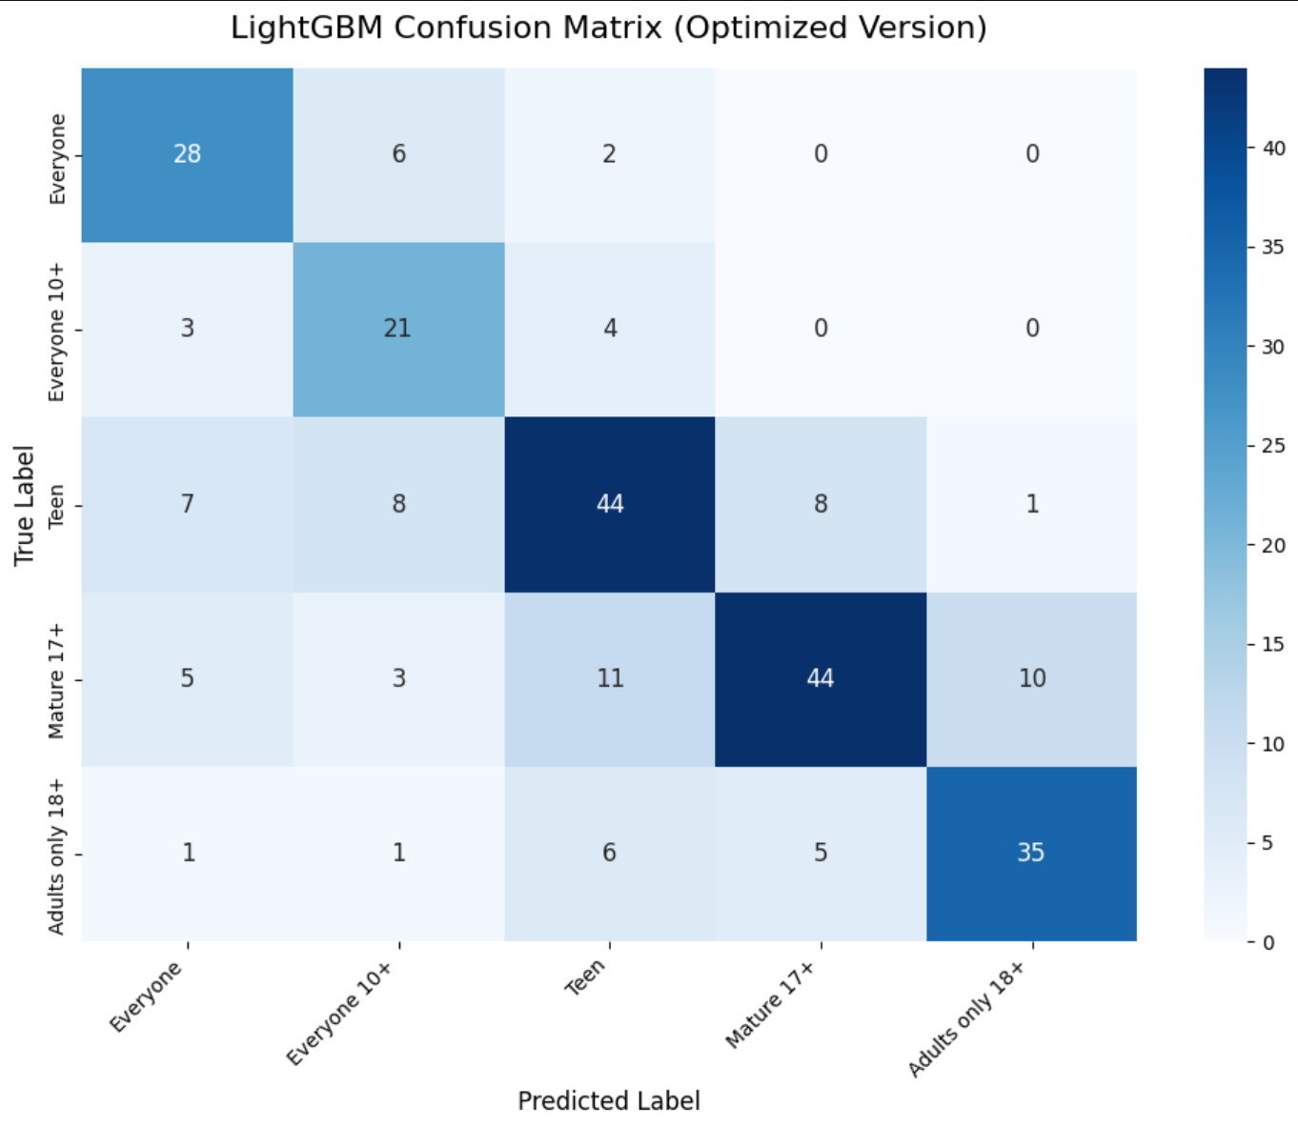
Model 4: LightGBM (The Constrained Underdog)
🔄 Model Intro
A lightweight GBDT framework known for its fast Histogram-based algorithms and aggressive Leaf-wise growth strategy.
⚙ Training Process
Configured to single-thread mode (n_jobs=1) to bypass C++ OpenMP deadlocks caused by small datasets. Applied rigorous Grid Search focusing on extreme leaf capacity constraints (min_child_samples) to curb its over-aggressive growth, followed by Early Stopping training.
Test Set Accuracy
0.780
Macro F1 Score
0.780
📊 Optimal Hyperparameters:
min_child_samples=15, num_leaves=15, max_depth=6
📉 Diagnosis: High leaf capacity thresholds forced the model to ignore rare but critical 'red-line' triggers

Slide 32
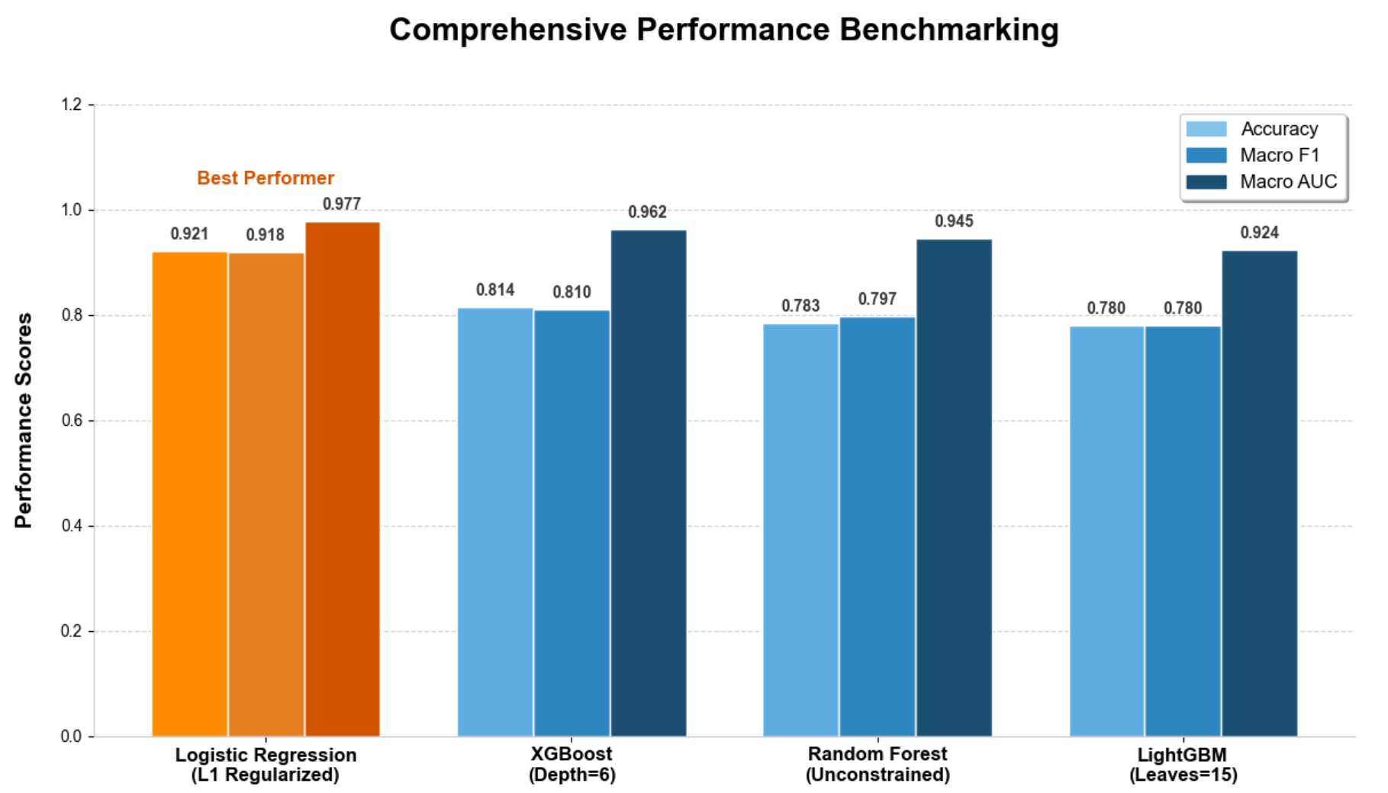
Comprehensive Performance Benchmarking
📈 Performance Insights: The Unexpected Winner
Through a horizontal comparison of three key indicators: Accuracy, Macro F1, and Macro AUC, we found that Logistic Regression (marked in orange) outperforms more complex tree-based ensemble models in all dimensions. It not only leads in numerical values but also has an overwhelming advantage in training efficiency and interpretability.
💡Core Conclusion
Under strict fair benchmarking, Logistic Regression outperforms complex tree models by a significant margin. This reaffirms that for this specific problem space, simplicity and linearity yield more robust and generalizable results than over-parameterized models.

Slide 33
The " Why " : Decrypting the Algorithmic Divergence
✅ The Triumph of Logistic Regression:
Sparsity Meets Business Logic
❌ Unconstrained Tree Models (e.g., Random Forest)
Suffer from severe overfitting (memorization) when processing high-dimensional wide tables. They capture random noise as patterns, failing to generalize to unseen critical cases in the app rating dataset.
Algorithmic Behavior: Pure L1 Regularization
Pure L1 Regularization (Lasso) successfully compressed 80.6% of redundant feature weights to exactly 0.
Perfect Business Mapping: " One-Strike Veto "
This mathematically perfectly aligns with Google Play's underlying " One-Strike Veto" logic (e.g., ticking 'Gore' immediately triggers a 17+ rating, regardless of other benign answers).
❌ Constrained Tree Models (e.g., XGBoost/LightGBM)
When we apply strict anti-overfitting rules (like min_child_samples), the algorithms treat "extremely rare but fatal violations" as minor noise and actively filter them out, causing a drop in accuracy.

Slide 34
Chapter 5:
Results Analysis and Safety Implications
Core Agenda: Deep Dive into Feature Impact, Data Quality & Safety Guidelines
Presenter:ZiXuan Wang
Notes:
In Chapter 5, we will delve into the results of our analysis and discuss their implications for safety.

Slide 35
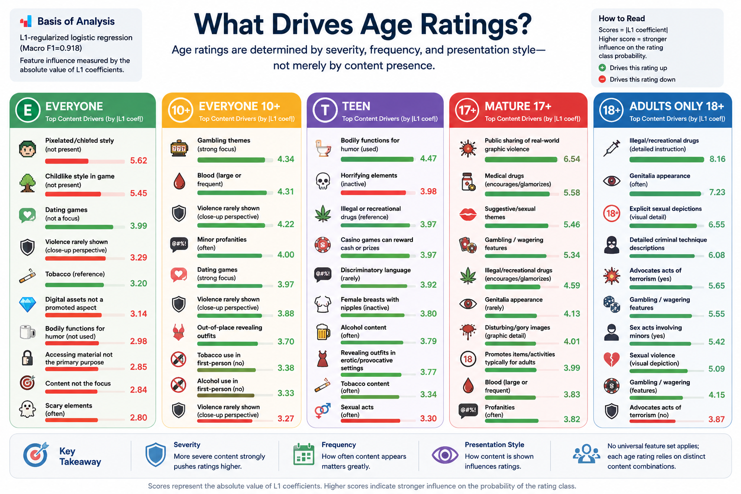
Notes:
Our analysis is based on the L1-regularized logistic regression model, which performed best in Chapter 4. By examining the model's coefficients, we can see which features most strongly influence each age rating.
This slide shows that different age ratings are driven by different content patterns. Lower ratings are mainly influenced by lighter signals such as visual style, mild violence, gambling themes, and minor profanity. As the rating increases, the key drivers become more severe and explicit, including drug references, graphic violence, sexual themes, gambling, criminal techniques, and sexual violence. The main takeaway is that age classification depends not only on whether content exists, but also on its severity, frequency, and presentation style.

Slide 36
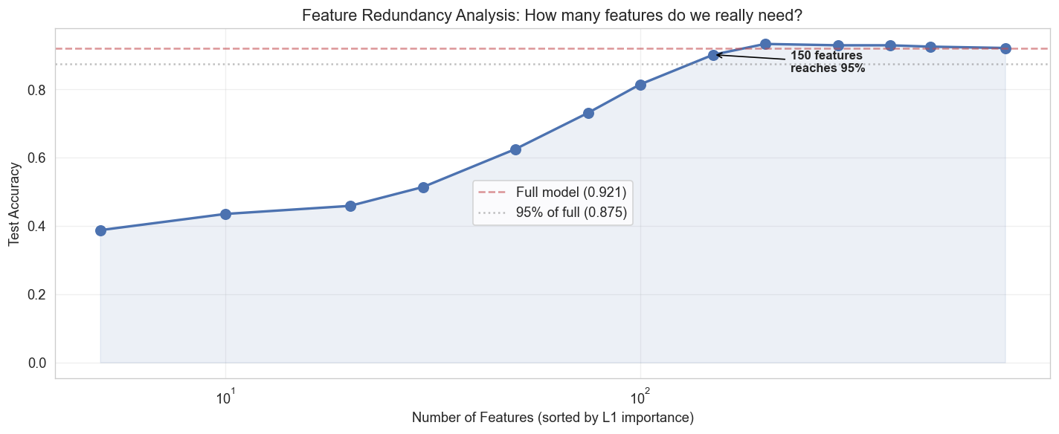
Questionnaire Redundancy:
More Questions Do Not Always Improve Performance
📈 Experimental Findings
Tested feature subsets (10, 50, 200, 758). Accuracy rose sharply to 200 features (0.933, 101% relative to full), then slightly declined with all 758 features, proving diminishing returns and redundancy.
💡 Key Conclusion
The Google Play questionnaire contains substantial redundancy. Most items provide little discriminative value, and using a subset of 200 high-information features is sufficient to match or exceed the performance of the complete dataset.
Peak Accuracy (200 Feat)
0.933
Full Model (758 Feat)
0.921
🎯 Practical Implications
Prioritize high-density features for research; simplify questionnaires to boost user completion efficiency and reduce data collection costs.
💡Insight: Excessive low-value data collection increases cost without benefit.
Notes:
We tested whether using fewer features could still yield good results. Interestingly, using just 200 key features actually achieved a slightly higher accuracy than using all 758 features. This indicates significant redundancy in the original questionnaire. Collecting excessive low-information data is not only unnecessary but also increases costs. This finding suggests that both researchers and platform designers could benefit from simplifying the questionnaire to focus on the most informative questions.

Slide 37
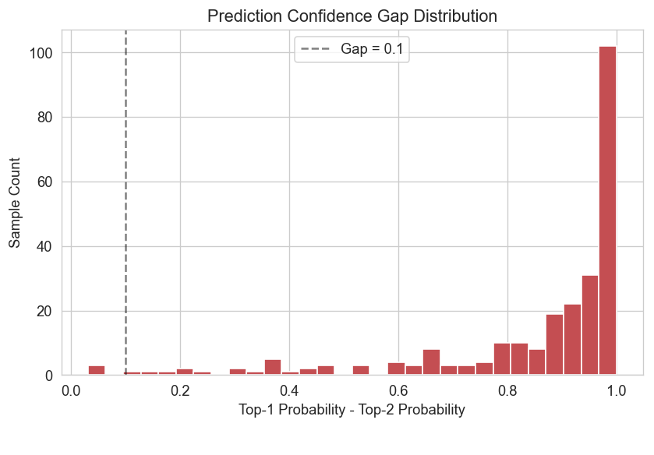
Uncertainty and Gray Areas in Age Rating
🔑 Key Observations
Uncertain samples cluster heavily at the boundary between 'Teen' and 'Mature 17+' categories. The gap between the top two predicted class probabilities is often negligible, indicating high ambiguity in content classification.
📋 Borderline Case Examples
Sample #239: Mature 17+ (0.443) vs. Teen (0.442).
These minuscule gaps (0.001) are not random errors but reflect genuine difficulty in applying rigid age labels.
Hotspot Zone
Teen ↔ Mature 17+
Min Probability Gap
0.001
💡 Practical Implications
Model uncertainty is a feature, not a bug. It can automate the flagging of borderline content for mandatory human review, improving fairness.
💡 Insight: Ambiguity stems from criteria, not just model limitations.
Notes:
By looking at the model's prediction probabilities, we identified the most uncertain cases. These are primarily concentrated between the 'Teen' and 'Mature 17+' ratings, where the model's confidence is very low. The Sample NO.239 shows that the difference between the top two predictions is minimal. This isn't just a model error; it highlights the inherent ambiguity in the rating criteria themselves. Therefore, model uncertainty can be a valuable tool to flag borderline cases for human review.

Slide 38
Structural Missing Values Are Informative Signals
🔍 Sentinel Values in Branching Logic
In questionnaires with conditional branching, values like '__INACTIVE__' or '__NONE__' are not random noise. They represent activated risk branches (e.g., a question about severe violence being inactive means no such content exists).
🧠 Core Analysis & Insight
Instead of discarding or imputing, we retained structural missing values. The L1 coefficients of the logistic regression model revealed that these sentinel features carry substantial positive/negative weights, indicating strong predictive power.
📚 Semantic Signal vs. Noise
In branching questionnaires, the absence or inactivity of a question is a direct semantic signal about the subject (e.g., no severe violence = lower risk). Treating these as mere missing data would erase critical context and degrade model accuracy.
Key Sentinel Values
__INACTIVE__
Logistic Reg L1 Coeff
± High Weight
💡 Strategic Recommendation
Retain sentinel values as categorical features; avoid mean/mode imputation to preserve the semantic information embedded in structural missingness.
💡 Note: Discarding these values would remove critical context for accurate risk classification.
Notes:
We found that structural missing values, like '__INACTIVE__' or '__NOT_APPLICABLE__', are not just noise. In a branching questionnaire, these values actually carry important semantic information. For example, if a question about severe violence is marked '__INACTIVE__', it indicates that the game doesn't contain such content, which is a strong signal for a lower age rating. Our model confirmed this by assigning significant weights to these sentinel values. Therefore, it's better to treat them as informative signals rather than simply imputing them.

Slide 39
Summary and Safety Recommendations
🔍Research Summary: Core Findings
🛡️Strengthen Validation & Human-in-the-Loop
For high-risk content, enforce strict validation and manual spot checks. Introduce human review specifically for borderline cases between "Teen" and "Mature 17+" to minimize misclassification errors.
Model Choice & Risk Drivers
L1 logistic regression outperformed others. High-risk ratings are dominated by violence, sexual content, drugs, and gambling, forming distinct feature combinations.
Redundancy & The Gray Zone Challenge
Questionnaires are highly redundant; key features suffice. The "Teen" and "Mature 17+" boundary is the most prominent gray area, with structural missing values holding predictive value.
📝Simplify Questionnaires & Avoid Overgeneralization
Eliminate low-information, redundant questions to reduce user burden. Exercise caution when drawing conclusions from categories with extremely small sample sizes to avoid misleading inferences.
Notes:
To summarize, this chapter has used our best model to analyze the key drivers of age ratings, identified significant redundancy in the questionnaire, pinpointed the 'Teen'/'Mature 17+' boundary as a major gray area, and highlighted the informative value of structural missing data. Based on these findings, we recommend strengthening validation for high-risk content, implementing human review for borderline cases, simplifying the questionnaire, and being cautious with small sample sizes. This analysis provides a data-driven foundation for improving age rating systems.

Slide 40
Thank you
for your listening
Project5 2026.6

